Slide 1
Verb 1
(page 01)

Slide 2

to action in the chair when you feeling tired because you hard worked in time.

Slide 3
to sit: /sit/ to … in the chair when you feeling tired because you hard worked in time.
Ex: She’s the girl who sits next to me at school.

Slide 4

.... to action to be in a position in which your body is flat on the floor, on a bed etc

Slide 5
to lie: /laɪ/ to be in a position in which your body is flat on the floor, on a bed etc
Ex: He was lying on the bed smoking a cigarette.

Slide 6
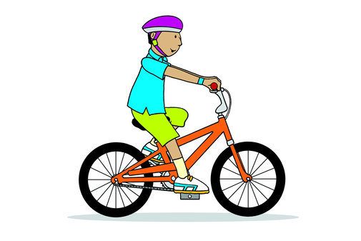
to sit on an animal, especially a horse, Bicycles and make it move along

Slide 7
to ride : /raɪd/ to sit on an animal, especially a horse, and make it move along
Ex: She learned to ride when she was seven.

Slide 8

.... to move yourself through water using your arms and legs

Slide 9
to swim : /swɪm/ to move yourself through water using your arms and legs
Ex: to move yourself through water using your arms and legs

Slide 10

…to move something to a particular place or position, especially using your hands

Slide 11
to put : /pʊt/ to move something to a particular place or position, especially using your hands
Ex: Where did you put the programmes?

Slide 12

…to support yourself on your feet or be in an upright position.

Slide 13
to stand :/stænd/ to support yourself on your feet or be in an upright position
Ex: It looks like we’ll have to stand – there are no seats left.

Slide 14
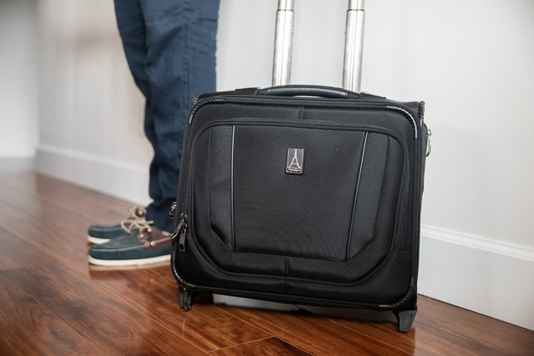
to carefully put something down somewhere

Slide 15
to set : /set/ to carefully put something down somewhere
Ex: She set the tray down on a table next to his bed.

Slide 16

... the activity of using a computer or a typewriter to write something

Slide 17
to typing :/ˈtaɪpɪŋ/ the activity of using a computer or a typewriter to write something
Ex: I’m no good at typing.

Slide 18
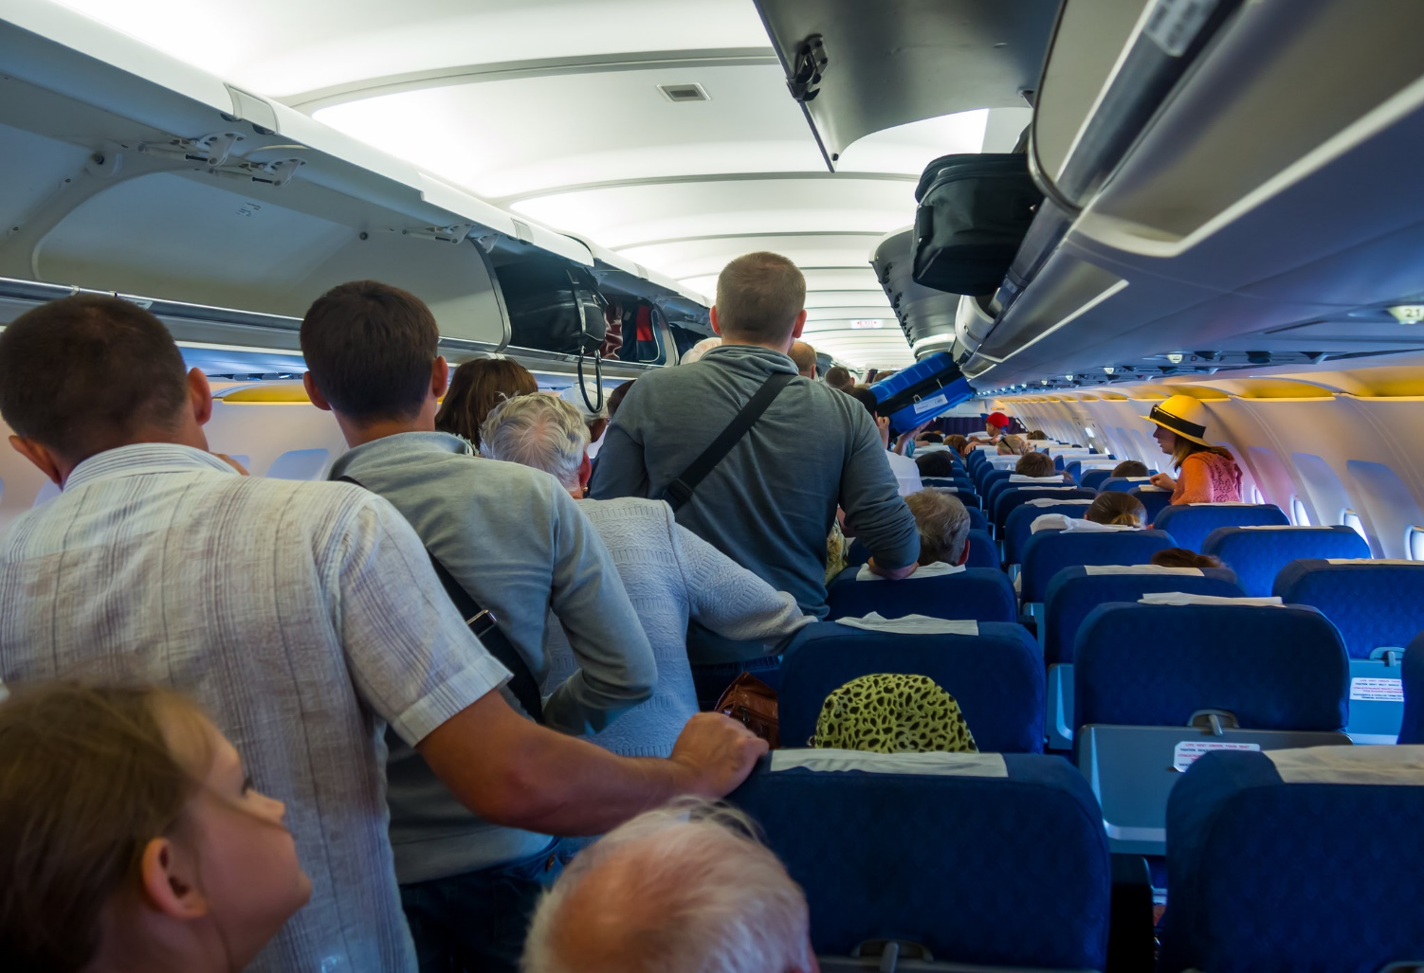
...to stay somewhere or not do something until something else happens, someone arrives etc

Slide 19
to wait :/weɪt/to stay somewhere or not do something until something else happens, someone arrives etc
Ex: Would you mind waiting outside?

Slide 20

.... to clean the dust, dirt etc from the floor or ground, using a brush with a long handle SYN brush

Slide 21
to sweep /swiːp/: to clean the dust, dirt etc from the floor or ground, using a brush with a long handle SYN brush
Ex: Bert swept the path in front of the house.

Slide 22
.... to move or go with someone or something from one place to another

Slide 23
to take out /teɪk/ :to move or go with someone or something from one place to another
Ex: The man is taking some paper out of a printer

Slide 24
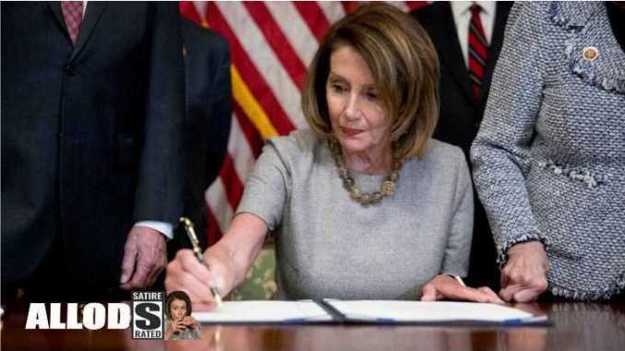
.... the act of writing your name at the end of a document to show that you agree with it

Slide 25
to sign :/ˈsaɪnɪŋ/ the act of writing your name at the end of a document to show that you agree with it
Ex: The artist had signed his name in the corner of the painting.

Slide 26
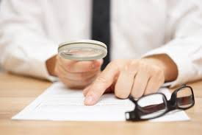
....to examine, consider, and judge a situation or process carefully in order to see if changes are necessary

Slide 27
…to review:/rɪˈvjuː/to examine, consider, and judge a situation or process carefully in order to see if changes are necessary
Ex: We will review your situation and decide how we can help you.

Slide 28
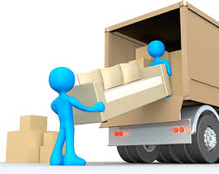
...to remove a load from a vehicle, ship etc unload something from something

Slide 29
.... to unload /ʌnˈləʊd/ to remove a load from a vehicle, ship etc unload something from something
Ex: The driver unloaded some boxes from the back of the truck.

Slide 30

.... to stop working or doing an activity for a time and sit down or lie down to relax

Slide 31
.... to rest/rest/ to stop working or doing an activity for a time and sit down or lie down to relax
Ex: If you’re tired, we’ll stop and rest for a while.

Slide 32

to fill a place or container or cover a surface with a large amount of things

Slide 33
to piled :/paɪl/ to fill a place or container or cover a surface with a large amount of things
Ex: He piled bread and milk into his basket.

Slide 34
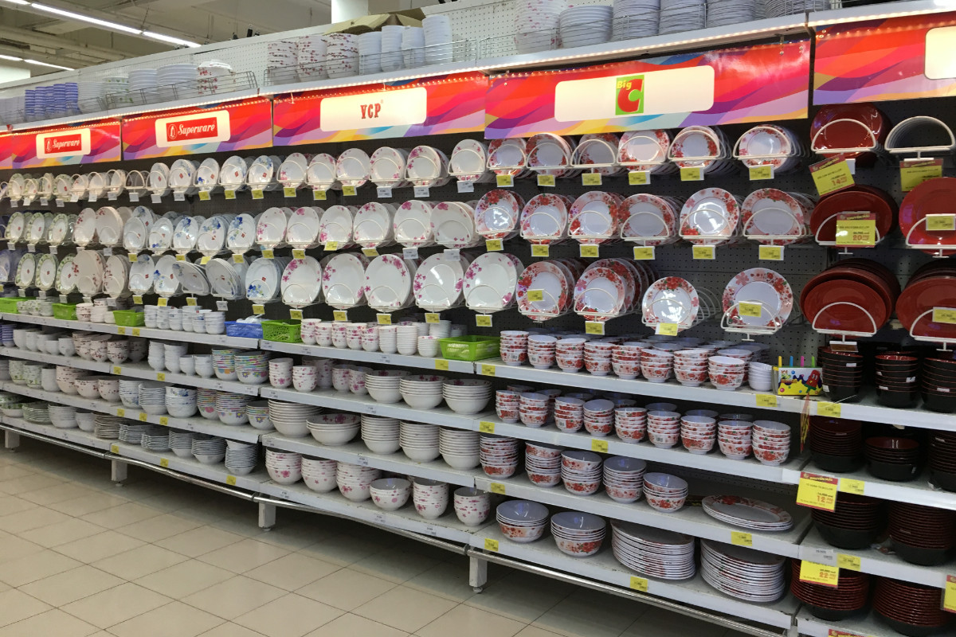
.... to organize or make plans for something such as a meeting, party, or trip

Slide 35
.... to arranged /əˈreɪndʒ/ to organize or make plans for something such as a meeting, party, or trip
Ex: Have you arranged to meet Mark this weekend?

Slide 36

… a large piece of cloth that is hung on a wall as a decoration

Slide 37
to hanging : /ˈhæŋɪŋ/ a large piece of cloth that is hung on a wall as a decoration
Ex: She hung the sheets on the washing line.

Slide 38
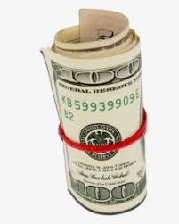
.... to make something into the shape of a tube or ball, or to become this shape

Slide 39
.... to rolled up to make something into the shape of a tube or ball, or to become this shape
Ex: Many animals roll up into a ball for warmth.

Slide 40
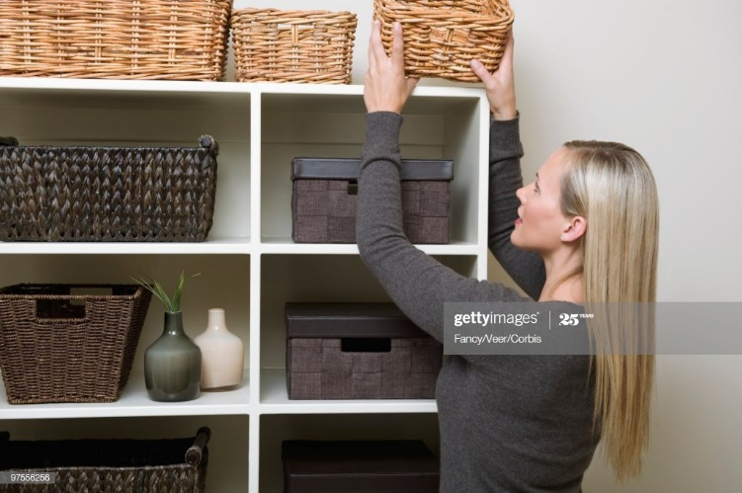
to put someone or something in a particular situation

Slide 41
to placing : /ˈpleɪsɪŋ/ to put someone or something in a particular situation
Ex: He carefully placed the folder back in his desk drawer.

Slide 42

.... if conditions are attached to an agreement, they are added to it and made a part of it

Slide 43
.... to attached /əˈtætʃ/ if conditions are attached to an agreement, they are added to it and made a part of it
Ex: a small battery attached to a little loudspeaker

Slide 44

to move a door, window etc so that people, things, air etc can pass through, or to be moved in this

Slide 45
to open : /ˈəʊpən / to move a door, window etc so that people, things, air etc can pass through, or to be moved in this
Ex: She heard a door open and then close.

Slide 46
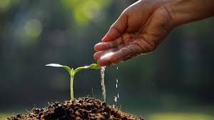
.... to put plants or seeds in the ground to grow

Slide 47
.... to planted / plænt / to put plants or seeds in the ground to grow
Ex: We’ve planted tomatoes and carrots in the garden.

Slide 48
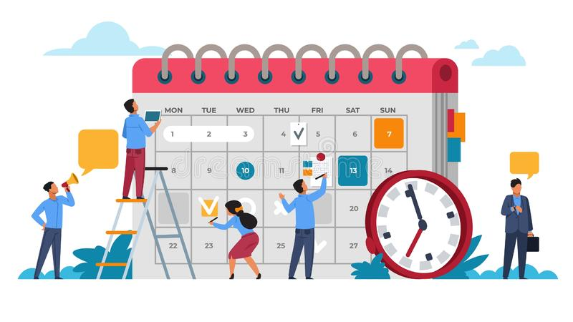
to make the necessary arrangements so that an activity can happen effectively

Slide 49
to organizing : /ˈɔːɡənaɪz/ to make the necessary arrangements so that an activity can happen effectively
Ex: Students need to learn how to organize their work.

Slide 50

if you scan a document or picture, you put it into a machine attached to a computer so that the information in the document can be taken into the computer and stored there

Slide 51
to scanned : /skænd/ if you scan a document or picture, you put it into a machine attached to a computer so that the information in the document can be taken into the computer and stored there
Ex: You scan the text into the computer, then edit it.

Slide 52
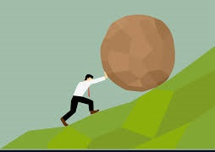
.... to trying

Slide 53
.... to try /traɪ / to take action in order to do something that you may not be able to do
Ex: He tried to control his voice.

Slide 54

to growing :

Slide 55
to growing : / ɡrəʊ /to make a business or part of a business bigger and more successful
Ex: The number of students at the college has grown from 200 to over 500.

Slide 56
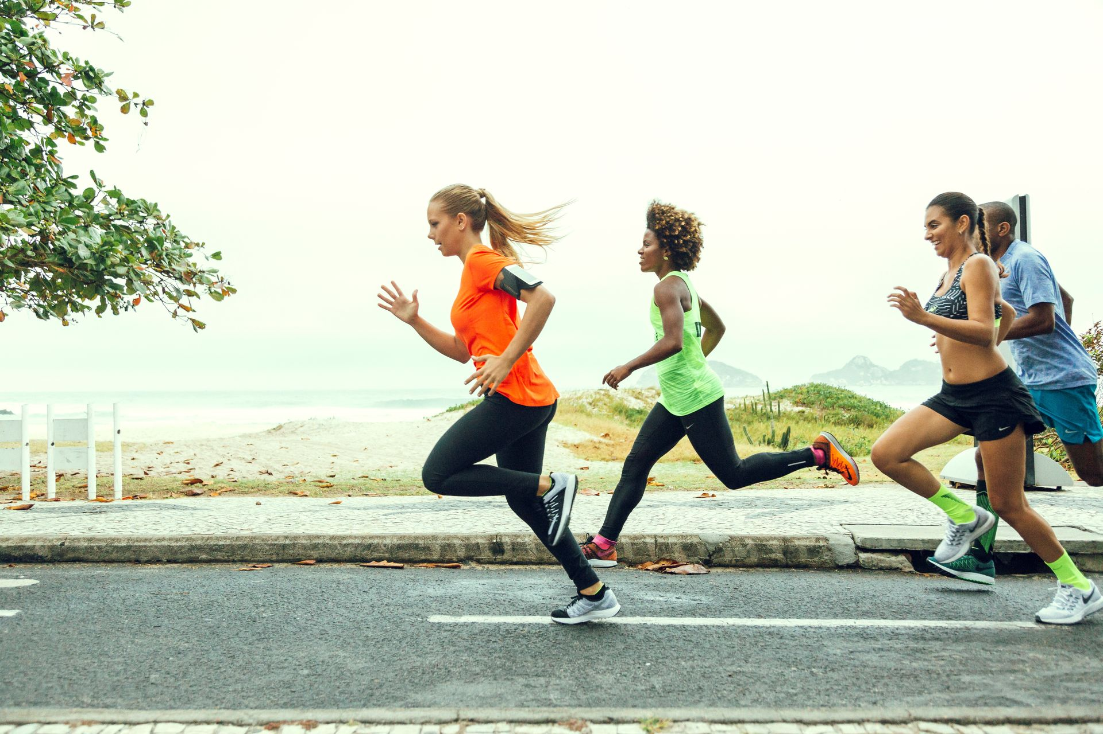
to runs :

Slide 57
to runs :/rʌn/ to move very quickly, by moving your legs more quickly than when you walk
Ex: Several people ran to help her when she fell.

Slide 58
Thanks you

